Slide 1

Object behaviour
Methods and Instance variables

Slide 2
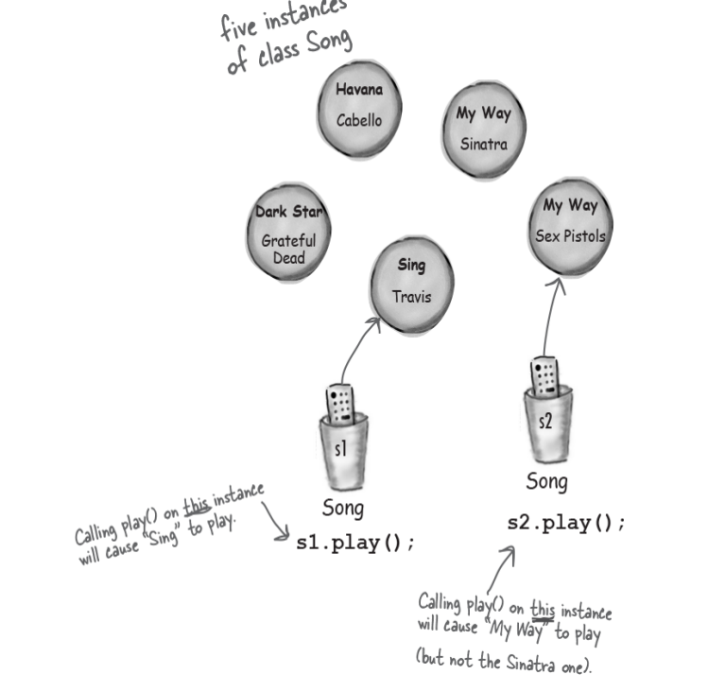
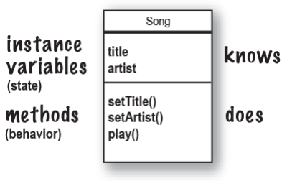
Class is a blueprint
Notes:
So the class is a blueprint, let’s say we have the following class Let’s agree that every song must be different, so the play method should be different on unique songs

Slide 3
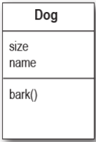
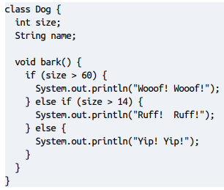
Instance variables change behaviour
Notes:
Let’s take for example Dog class, the name shouldn’t interfere with the bark method but size might Like this case

Slide 4
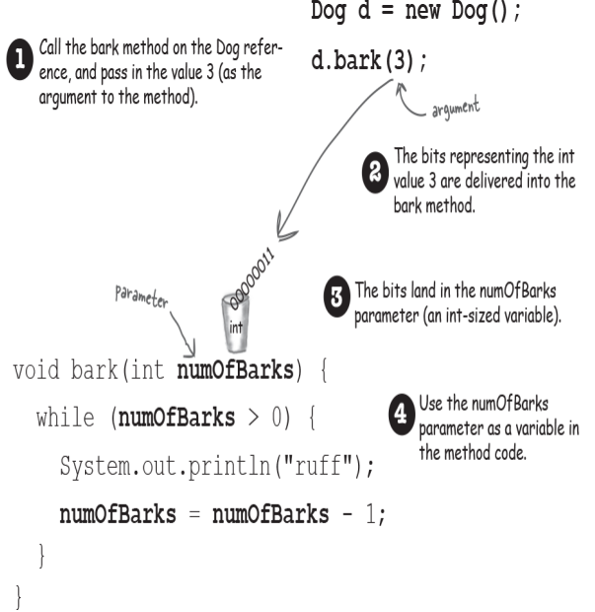
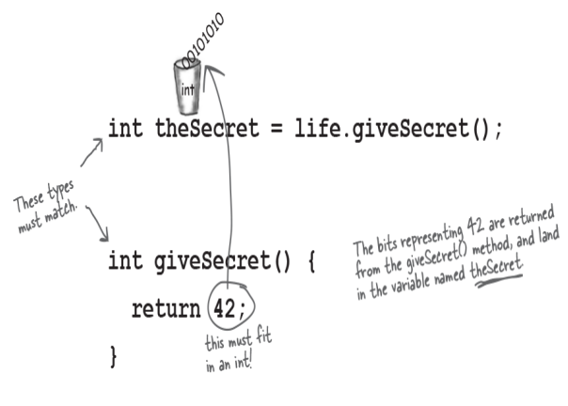
Sending and receiving things
from methods

Slide 5
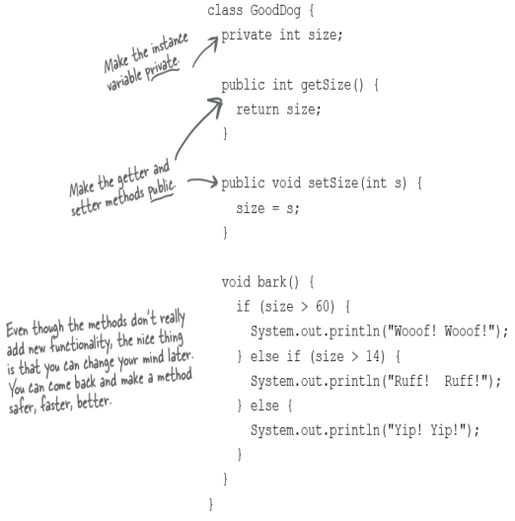

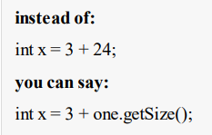
Encapsulation

Slide 6
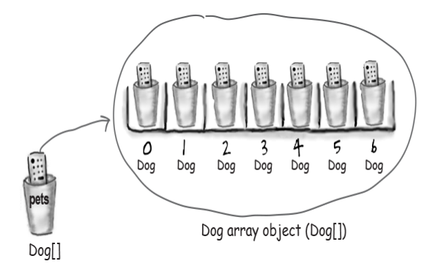
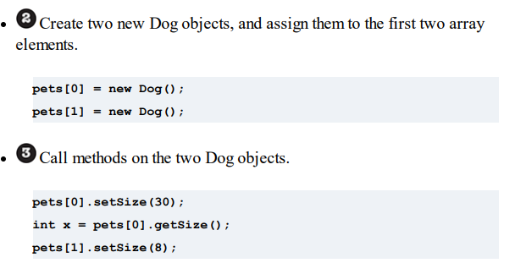
Handling arrays with objects

Slide 7
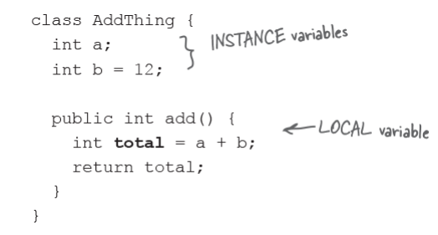
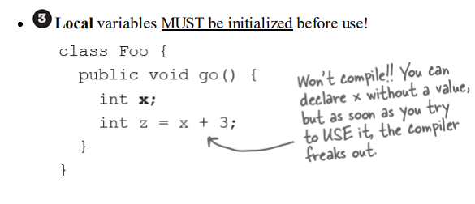
Instance vs Local Variables

Slide 8
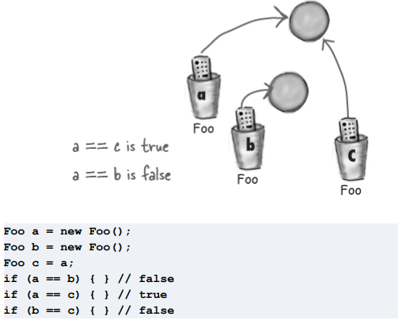
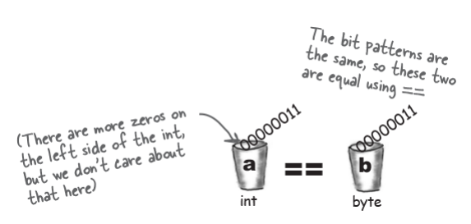
Comparing variables
(primitives or references)

Slide 9
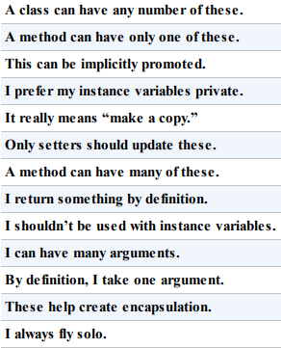
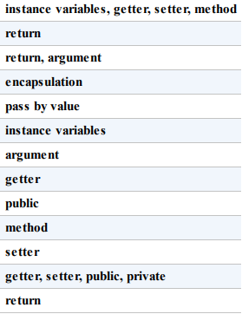
Instance variable
Argument
Return
Getter
Setter
Encapsulation
Public
Private
Pass by value
method

Slide 10
TODO
Create a program that contains at least three of: Song, Dog, Radio, Person, Car proving that instance variables do affect behaviour
Have at least 2 Methods in each class that accept parameters and 2 methods that return something relevant
All instance variables must be private and getters and setters must be used for all of them (Intellij can generate them for you, Investigate! )
Have at least one method in each class that uses a local variable

